Slide 1
Presentation OSG202 Team 3
Nguyen Huu Trung – HE141239
Luc Duong Hai – HE141223
Nguyen Long Phuong – HE141219
Ha Duc Hanh – HE141144

Slide 2

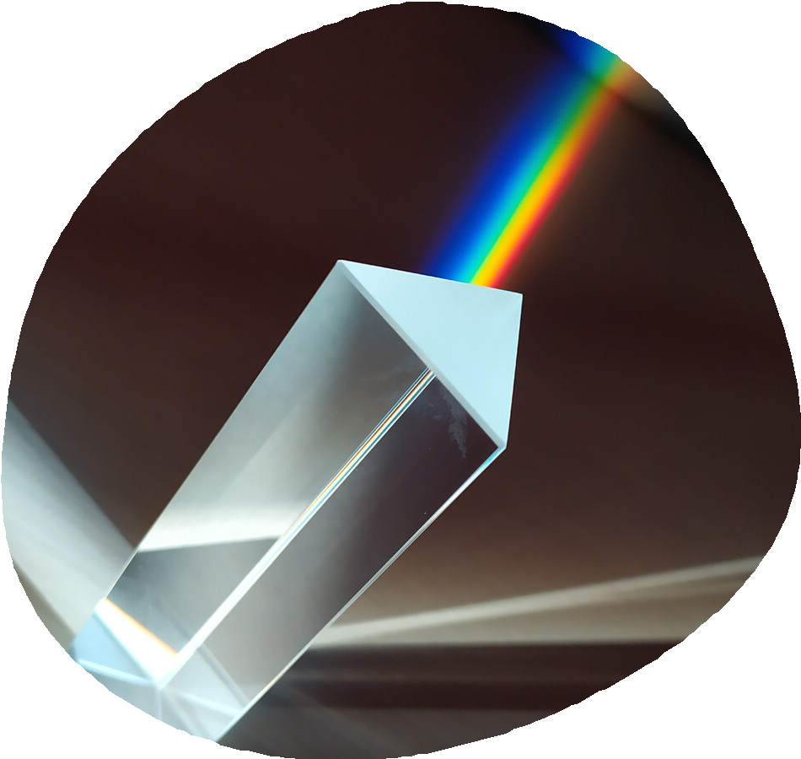
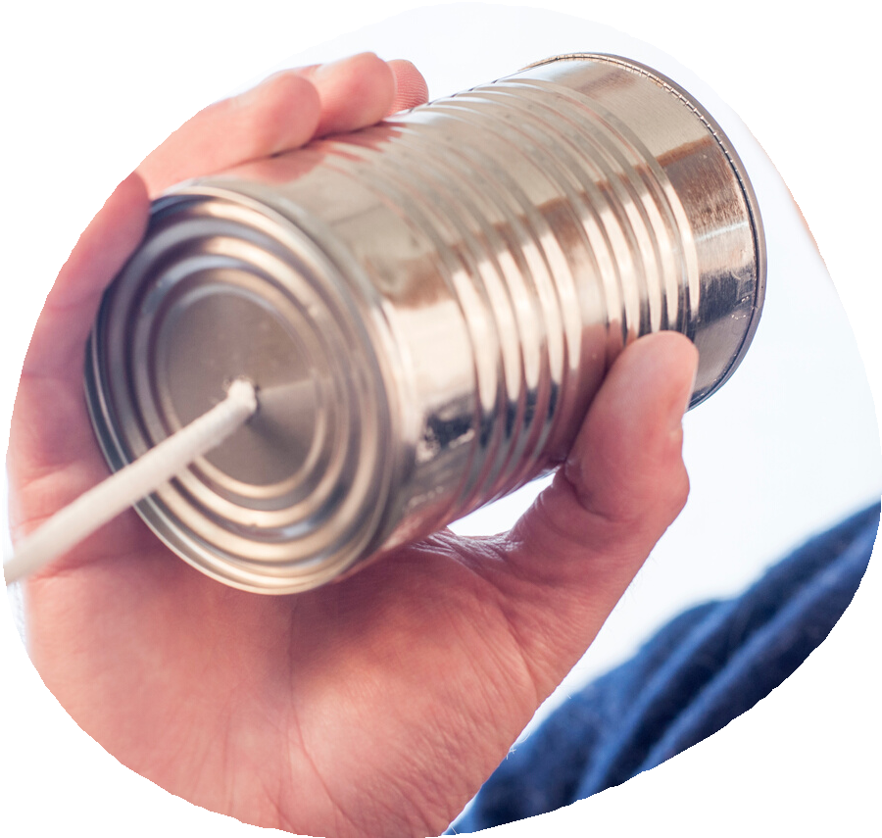
INTRODUCTION
EXPLAIN PROJECT
CONCLUSION

Slide 3


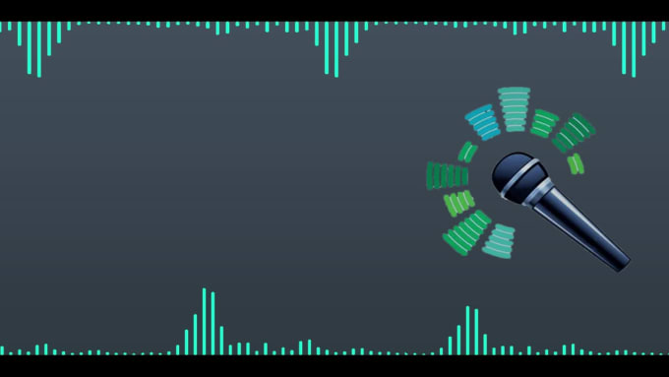

Analyze and process audio
Download a song
Detect pauses/stops in the song
Separate the song into multiple smaller parts containing complete sentences
Use fpt.ai speech-to-text engine to convert the parts (of the song) into texts.
- Save output into a lyric.txt file.
Download a song
Separate the song
Convert to text
Detect pauses/stops in the song

Slide 4

Explain project

Slide 5
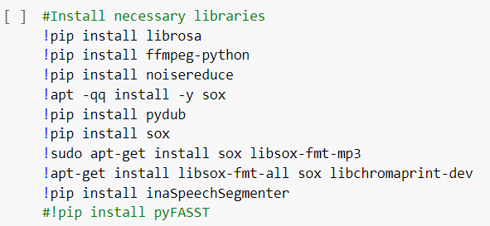
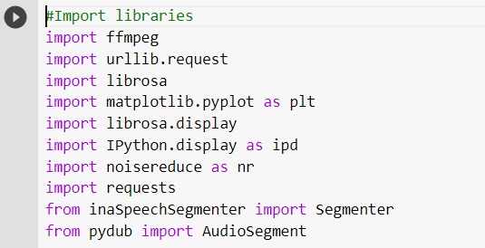
INSTALL NECESSARY LIBRARIES

Slide 6
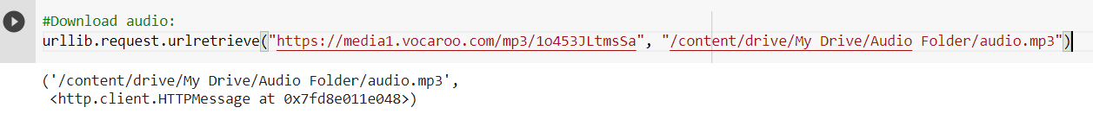
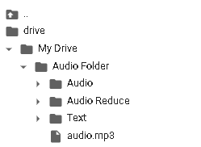
DOWNLOAD A SONG
+ Using “urlib.request”
+ Result:

Slide 7
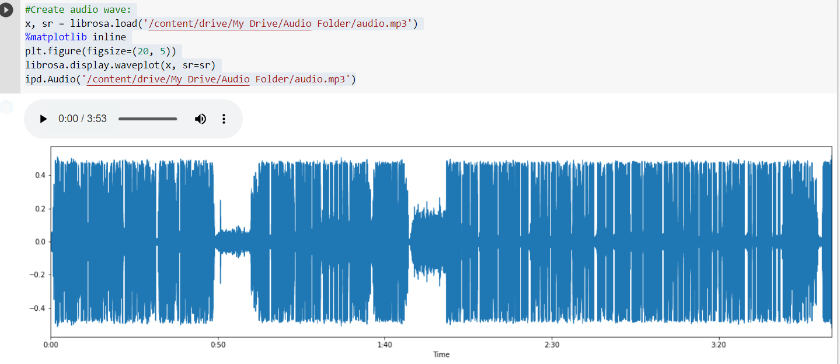
AUDIO WAVE DEFAULT
Using librosa to create audio wave

Slide 8
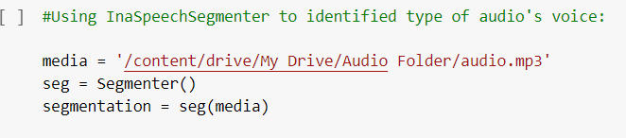

IDENTIFY AUDIO VOICE
Using InaSpeechSegmenter to identified type of audio's voice
------------------- Result -------------------

Slide 9
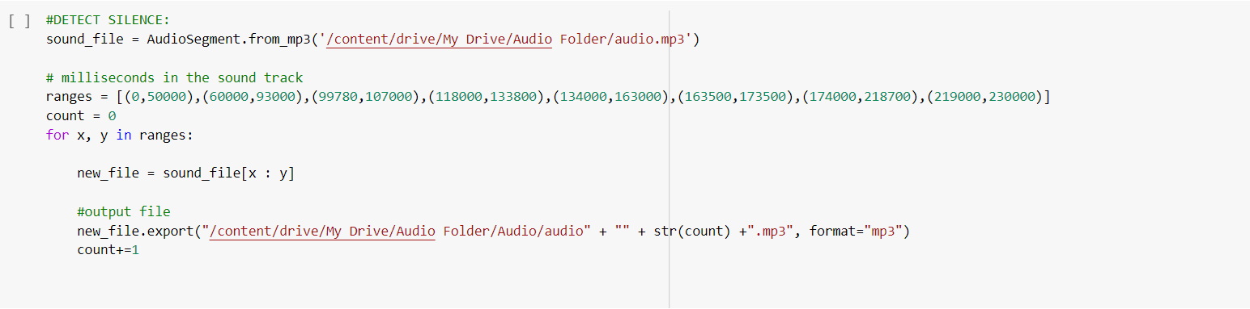
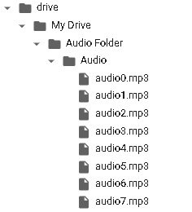
SPLIT AUDIO FILE
Using InaSpeechSegmenter and pydub to split audio file
------- Result -------

Slide 10

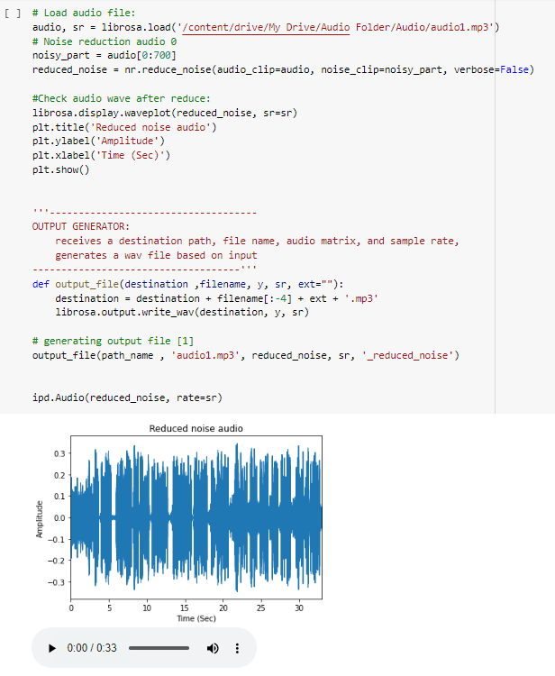
REDUCE NOISE
Using noisereduce to create audio wave
#REDUCE NOISE:
'''-------------------REDUCE NOISE ONE BY ONE--------------------'''
'''---Because once audio files had different noisies part so we have to detected one by one to get the good one ---’‘’
‘’’------ Example: noisy_part_audio1 = [0:10000]
noisy_part_audio2 = [0:700]

Slide 11
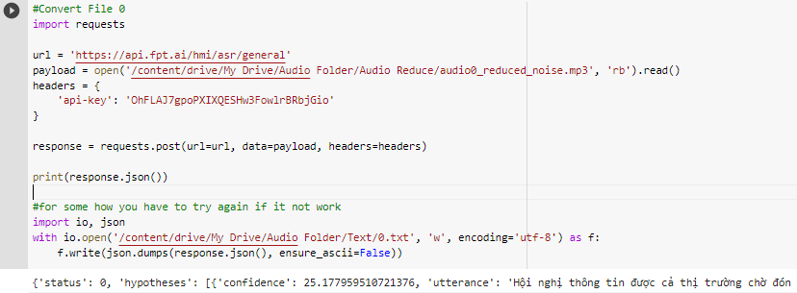
#API FPT:
'''--For somehow FPT.AI API (free API) will get limit rate to use then we have to using more codelines--'''
'''-- Once audio we will try once API --'''
'''-- Anyway, if it's got limited. Don't worry. We prepared, below are some API keys we prepared, try it.. --'''
'''-- nYvfiwnSbtuKy0OK37W4aTVYaVzM3q3Q: Key 1
zMMA0wOD4S0dlHNtIoULGickGb0ojvt1: Key 2
GZhmL9nML2pJ8dncoXQ8IMLXvPnDQsHN
aDStwoJ17CqKwfF1QZ3gxA4aCo0exMnk
iedpov8BdCqIFWxXNr4LeAIIaAjcsfEo
EdyezNlk7VhZEuiz3N7qGHyKZ5KtRg8Y---'''
# if not work.. Connect FPT.AI:
# + Sign in an account then make your own API.
USING FPT.AI TO CONVERT AUDIO TO TEXT
Using fpt.ai API to convert audio to text
'''------------------------------------
USING API FPT:
use fpt.ai speech-to-text engine to convert the parts (of the audio) into texts
------------------------------------'''

Slide 12
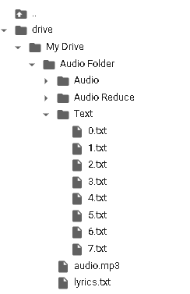
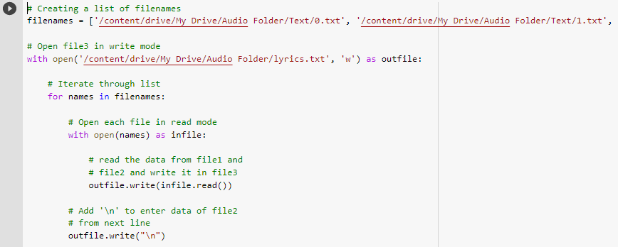
COMBINE TEXTS TO TEXT

Slide 13

CONCLUSION
- Convert audio voice to lyrics
- This audio processing program is very interested and focused because it is can be applied to many areas of life

Slide 14
THANKS FOR WATCHING

